Slide 1
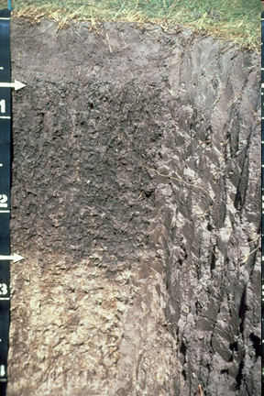
Soils are more than a pile of dirt!
https://www.soils.org/stickers
Soils are an organized mixture of organic & mineral matter created by the interplay of five soil forming factors.
s = f (cl, o, r, p, t …)
Jenny 1941

Slide 2
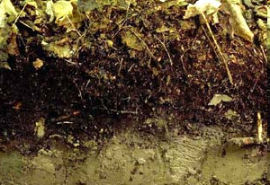
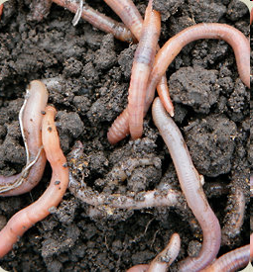
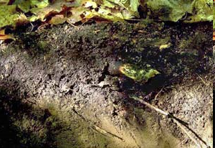
Notes:
http://www.nrri.umn.edu/worms/forest/soil.html

Slide 3
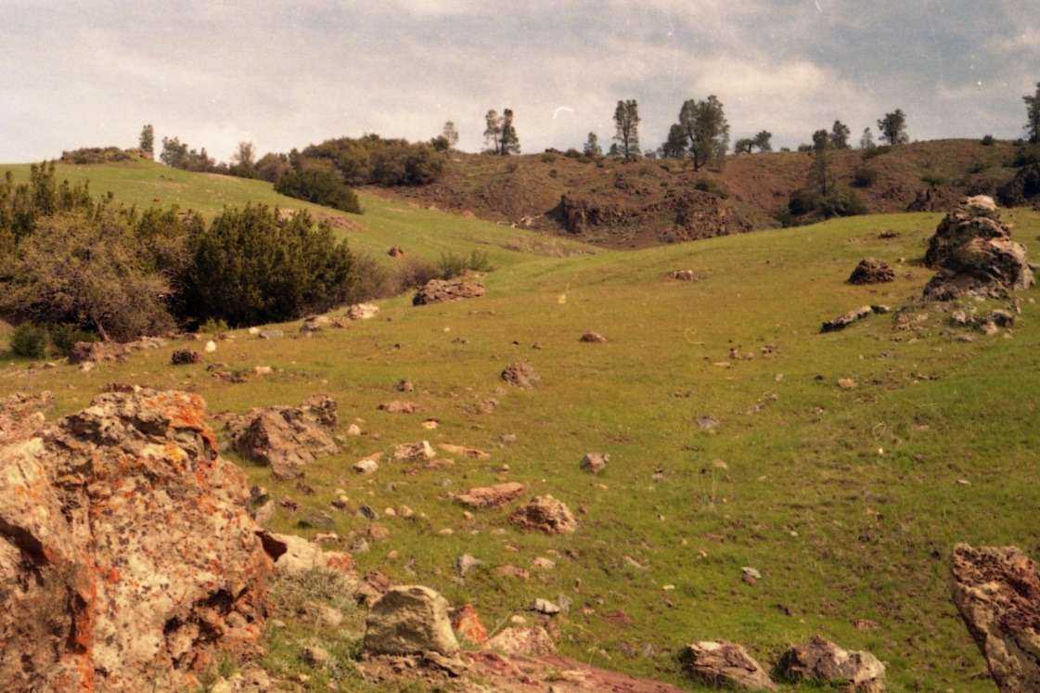
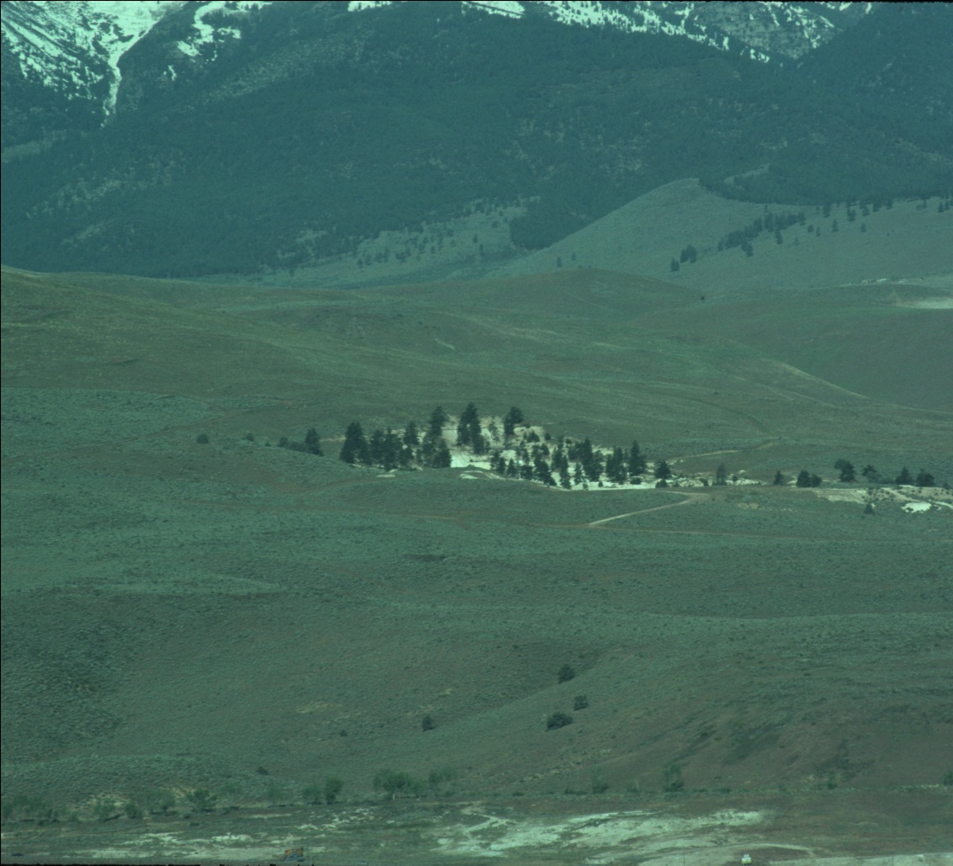
Notes:
http://cain.ice.ucdavis.edu/plants_animals/plants/serpentine_book
Serpentine and other ultramafic rocks are a unique substrate for plants. Their composition resembles that of the mantle that is many kilometers beneath the crust of Earth, rather than the composition of continental masses. Many plants will not grow in a chemical environment that is related to the mantle more than to the continental crust, leaving serpentine landscapes open for special suites of plants that can compete well in them. Because of these distinctive suites of plants and many plant species that are found only on serpentine (serpentine endemics), serpentine landscapes are of special interest to botanists

Slide 4
Two types of rock weathering

Slide 5
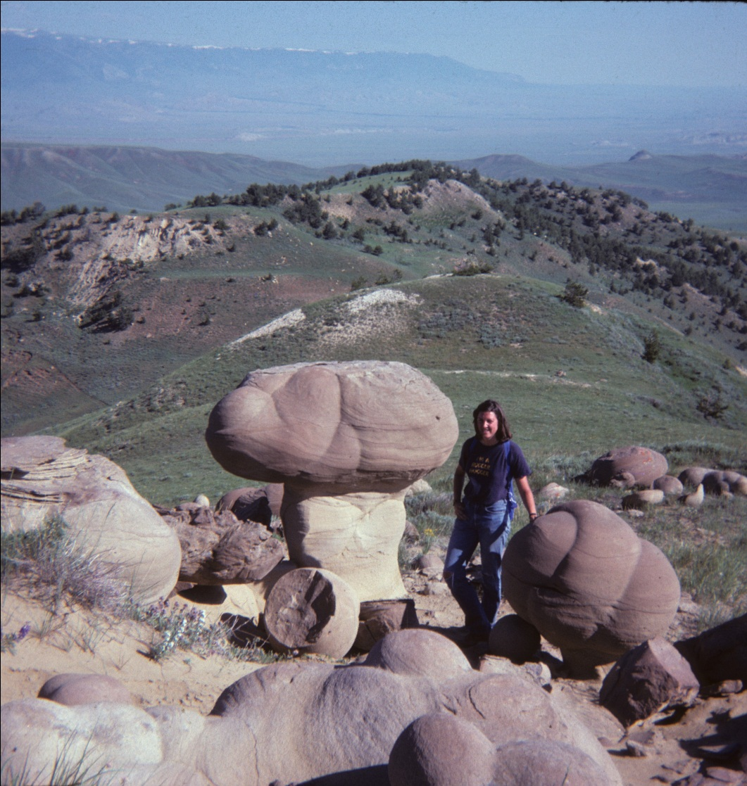
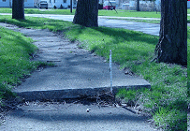
Notes:
http://www.ci.oregon.oh.us/ctydpt/publicservice/sidewalk/inspection/inspection.htm

Slide 6
Two types of chemical weathering
Na- feldspar
Soluble Components
kaolinite
limestone
Soluble Components

Slide 7
Bowen Reaction Series
Mafic

Slide 8
Categories of chemical reactions in soil

Slide 9
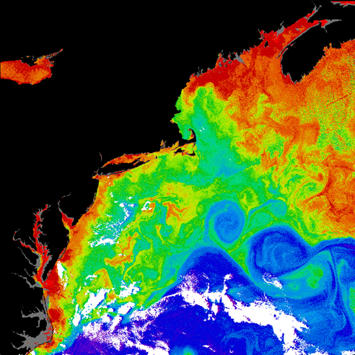
Denudation is a connection between the land and oceans

Slide 10
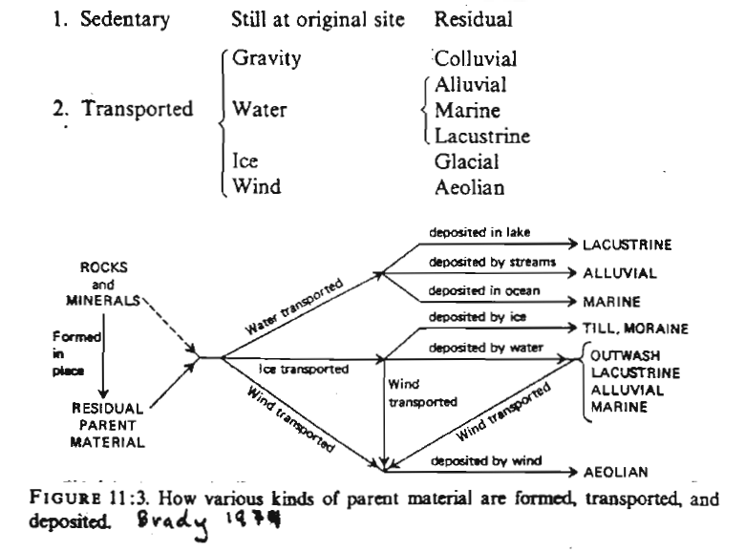
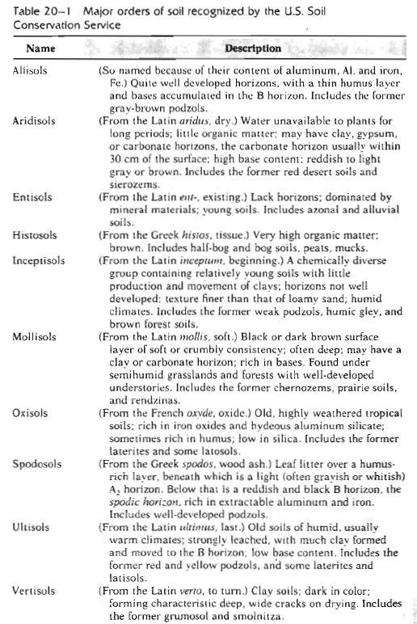
Composition & ways to classify soils
Parent Material Source & Deposition Site
Soil Orders Defined by their Profiles
Texture
Ehrlich et al. 1977

Slide 11
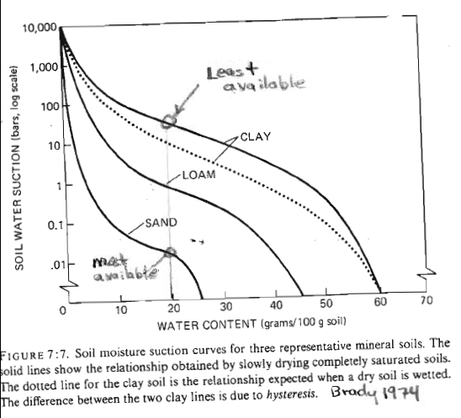
Soil texture is important because

Slide 12

Soil profiles consist of horizontal layers
called horizons
O
O_{i}
O_{e}
O_{a}
A
B
Mineral Soil
C

Slide 13
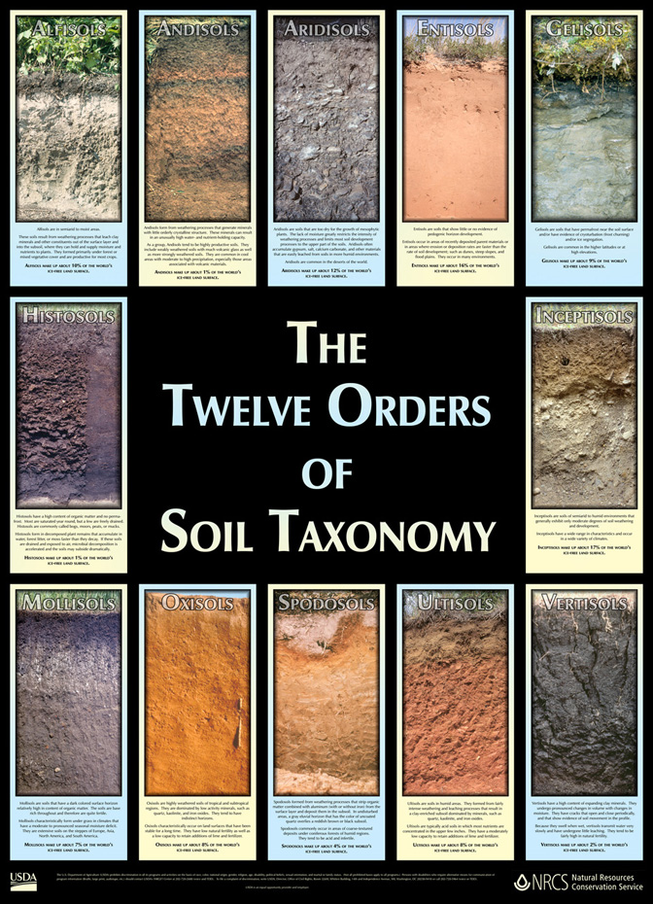
Notes:
http://soils.usda.gov/gallery/

Slide 14
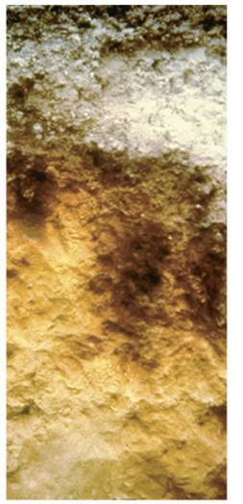
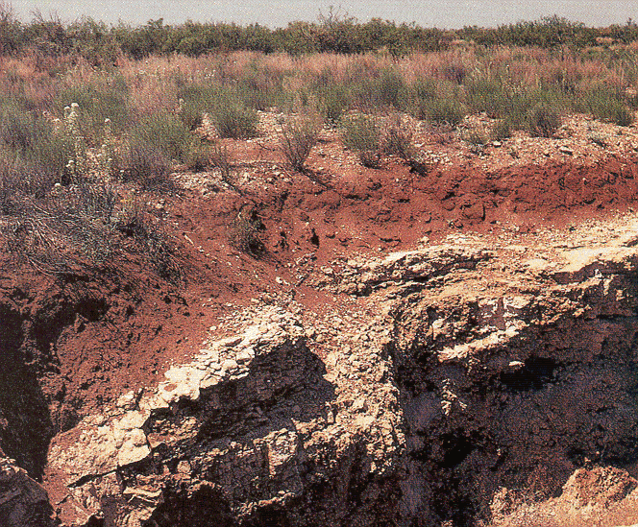

Slide 15
Soil Organic Matter (SOM)
Different compounds decay at different rates
Guo and Gifford 2002

Slide 16
Soil chemistry is influenced by clay minerals
and SOM
Secondary Clay Minerals
Brady 1974

Slide 17
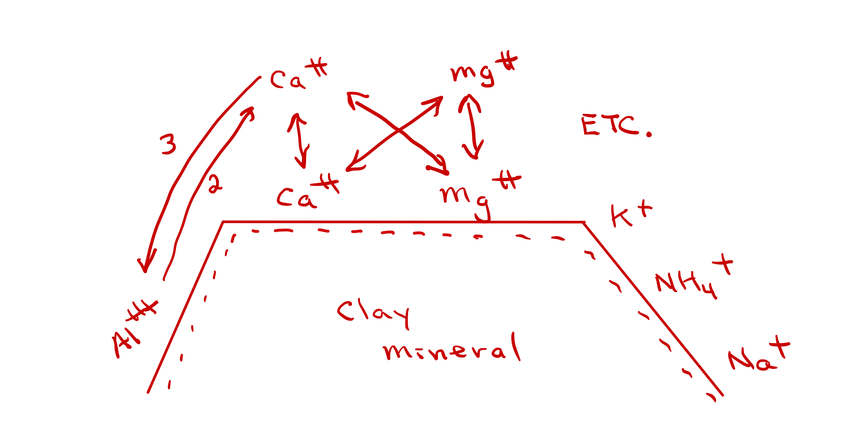
Soil Chemistry
(CEC & pH Buffering)

Slide 18
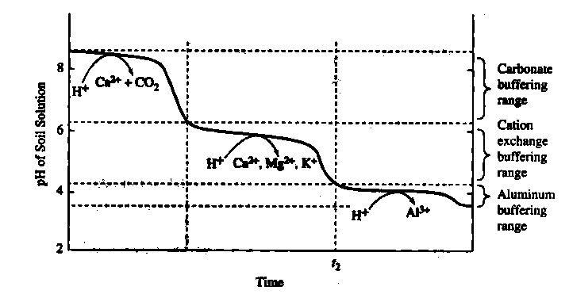
Decline in soil pH over time in response to
atmospheric acid inputs.
From: Spiro, T.G., and W. M. Stigliani. 2003.
Chemistry of the environment.
Page 301. 2nd edition. Prentice Hall, Upper Saddle River, NJ

Slide 19
Stages of buffering if present in soils
1) Acidic rain can be neutralized if calcium carbonate is present
Limestone: CaCO₃ + H₂SO₄ --> CaSO₄ + H₂CO₃
CaCO₃ + 2HNO₃ --> Ca(NO₃)₂ + H₂CO₃
The calcium sulfate is soluble in water and hence the limestone dissolves and crumbles.
H₂CO₃ --> CO₂ gas + H₂O
The original acid (hydrogen ions) have been converted to water in these reactions.
2) Cation exchange buffering is limited by the number of exchange sites occupied by Na^{+,} K⁺, NH₄⁺, Ca⁺⁺, Mg⁺⁺
3) Aluminum buffering is rarely depleted b/c Al containing minerals are common in soils.
When pH drops below 4.2, H⁺ dissolves the Al-containing minerals.
Al₂Si₂O₅(OH)_{4kaolinite} + 6H⁺ = 2Al₃⁺_{aq} + 2H₄SiO_{4aq} + H₂O
NaAlSi₃O_{8plagioclase} + 4H⁺ + 4H₂O = Na⁺_{aq} + Al³⁺_{aq} + 3H₄SiO_{4aq}
Al(OH)_{3gibbsite} + 3H⁺ = Al³⁺_{aq} + 3H₂O
Al³⁺ can be toxic to plants and aquatic organisms.
Notes:
http://www.elmhurst.edu/~chm/vchembook/196soil.html

Slide 20
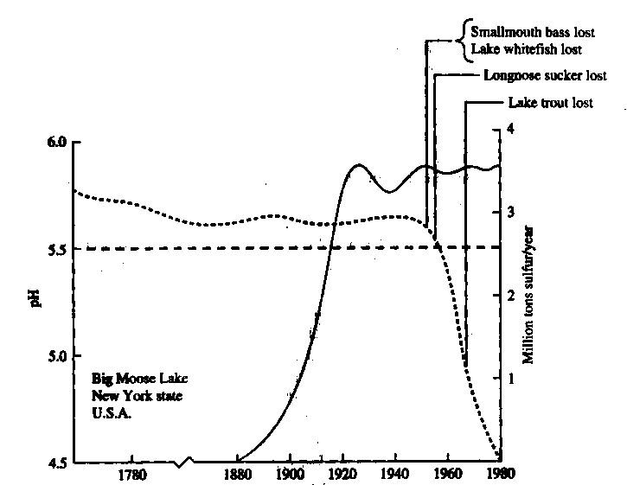
Polluting activities may be far displaced in time from their environmental effects.
Lake pH
Dashed line: lake pH, Solid line: upwind SO₂ emission from the U.S. industrial midwest.

Slide 21
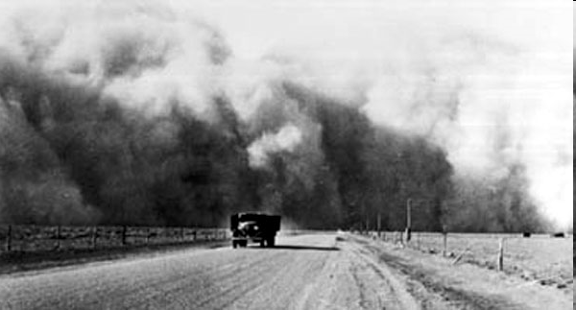
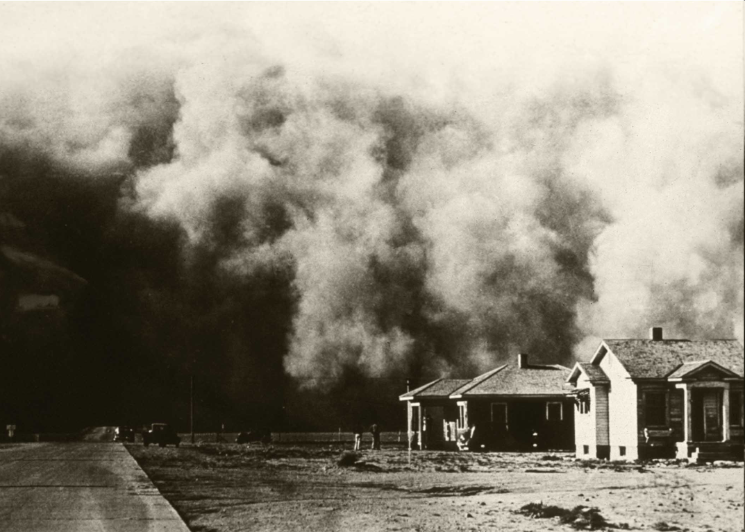
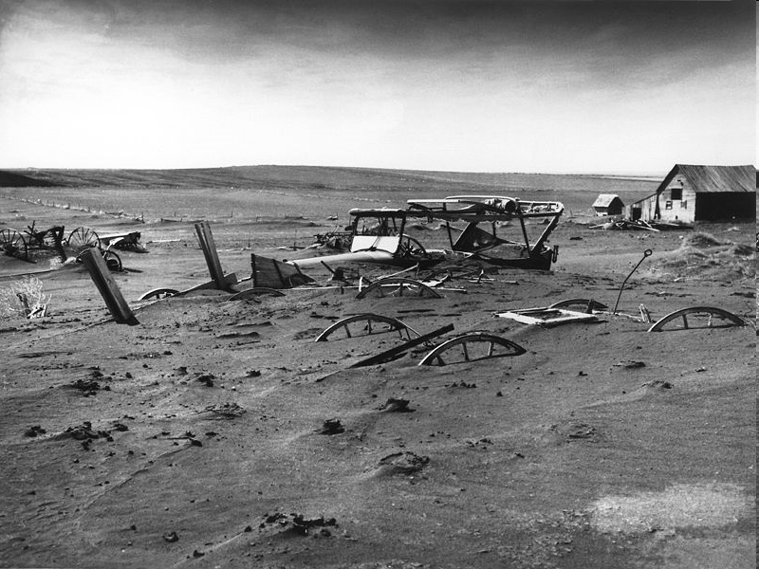
The Dust Bowl
Notes:
http://www.paper-dragon.com/1939/gallery/pages/1935%20-%20Dust%20bowl.html
http://www.motherjones.com/blue_marble_blog/archives/2008/02/
Location: Dallas, South Dakota
Date: May 13, 1936
Buried machinery in barn lot during the Dust Bowl, an agricultural, ecological, and economic disaster in the Great Plains region of North America.
Source: USDA photo by Sloan [1], Image Number: 00di0971

Slide 22
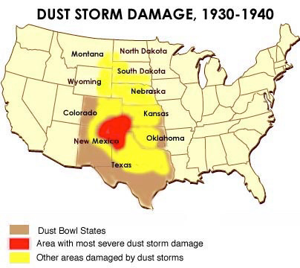

Slide 23
Soil Erosion – U.S. case study
May 1934
1935
Dust Bowl
1954-1956
c.a. 1988
Topsoil blown off the Great Plains reaches ships 200 miles offshore in the Atlantic
Soil Conservation Service (SCS) established after dust from the Great Plains seeped into congressional hearing room
~89 million acres of cropland destroyed (9 million) or damaged
Wind erosion damaged more land than in the 1930s
“Enough topsoil erodes … each day to fill a line of dump trucks … 3,5000 miles long …” Miller 1988

Slide 24
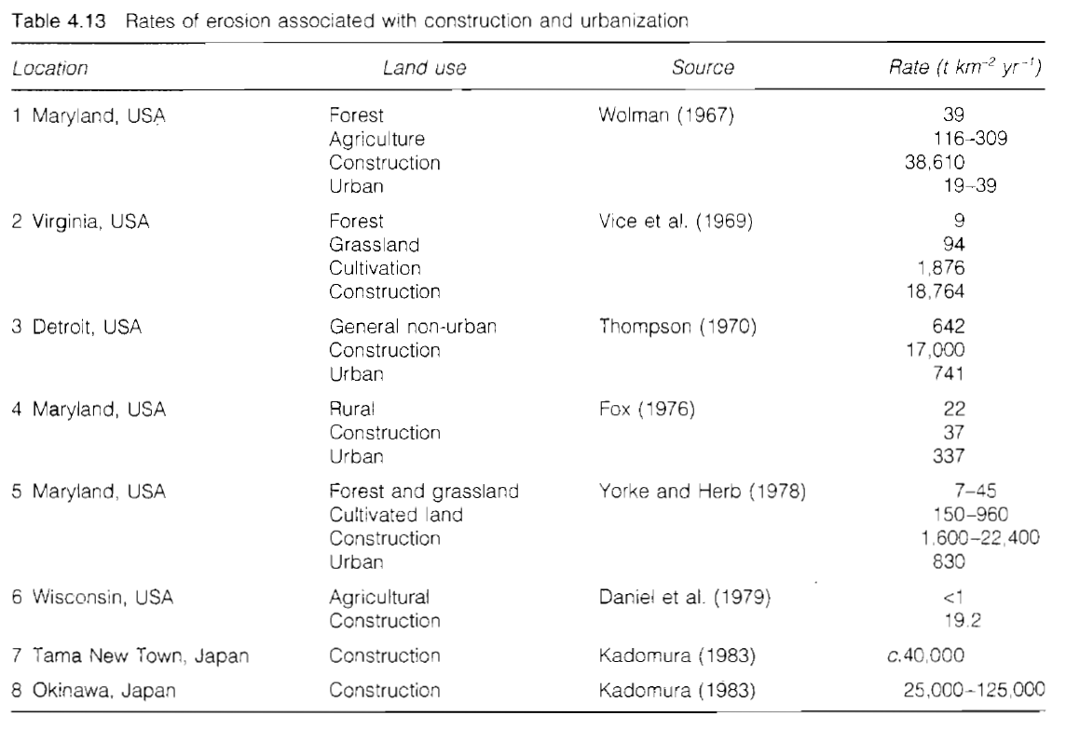
Land use affects erosion rates both locally & globally!
Goudie 2000

Slide 25
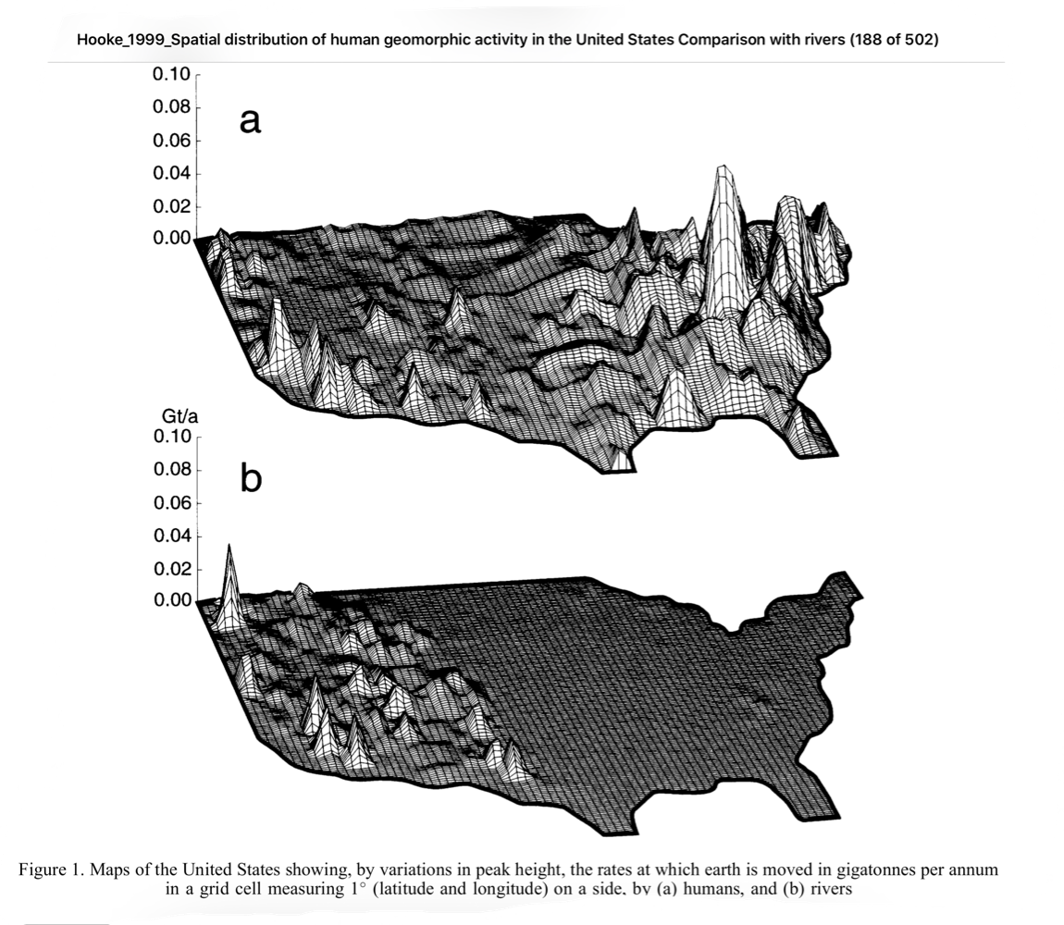

Slide 26
If we do things differently, we can get different results.
Pimentel et al. 1995

Slide 27
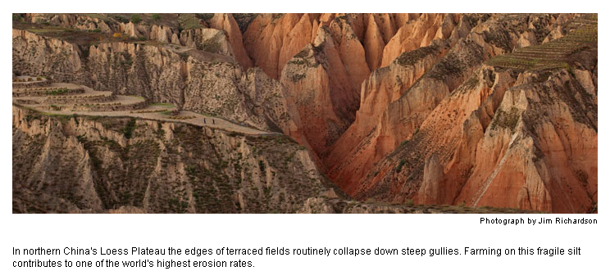
“As water wears away stones and torrents wash away the soil, so you destroy man’s hope”
Job 14:19
National Geographic
Sept. 2008
“With eight billion people, … We’re simply not going to be able to keep treating it like dirt”
David Montgomery
Univ. of Washington
Notes:
The Chinese Loess Plateau was once a high, flat plain in northwestern China, but now more than 70% of the area is gully-hill dominated, owing to massive soil erosion during the later Quaternary and human-induced accelerated soil erosion in recent centuries.
Agriculture commenced on the Loess Plateau about 7000 years ago and hence it can be considered one of the important birthplaces of Chinese and world agriculture (Zhu 1989). It still occupies a special position in Chinese national economic development (ESD-CAS 2001). Ongoing soil erosion on the Loess Plateau resulting from unique geological and geomorphologic characteristics, easily eroded loess, rainstorm disasters, and human activities, is the main environmental constraint on local agricultural and socioeconomic development (Jing and Chen 1983; Tang et al 1991; He et al 2003).
Mountain Research and Development, 24(4):342-347 (2004). https://doi.org/10.1659/0276-4741(2004)024[0342:SEDOTC]2.0.CO;2

Slide 28
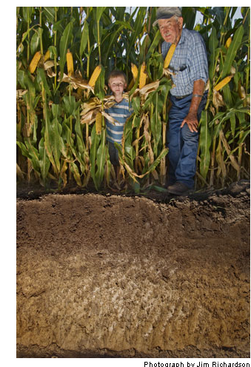
“The land takes care of us as we care for it …”
Cletus Reed
80-yr old
Iowan farmer
National Geographic
Sept. 2008
Notes:
http://ngm.nationalgeographic.com/2008/09/soil/richardson-photography
“After losing a foot of soil from parts of their Iowa corn farm, the Reed family changed the way they prepare fields for planting, to limit erosion. Cletus Reed, 80, hopes his grandson, Sam will work these acres someday. “The land takes care of us as we care for it,” he says.” National Geographic Sept. 2008 pg. 107

